Slide 1
A Comparison of Land Classification Algorithms
CSC 497 - Interdisciplinary Project 2019
By Andrea Nesdoly Supervisor: Dr. Neil Ernst

Slide 2

Outline
Goal
Background
Study Area
Data
Methods
Results
Accuracy Assessment
Statistical Comparison
Conclusion

Slide 3
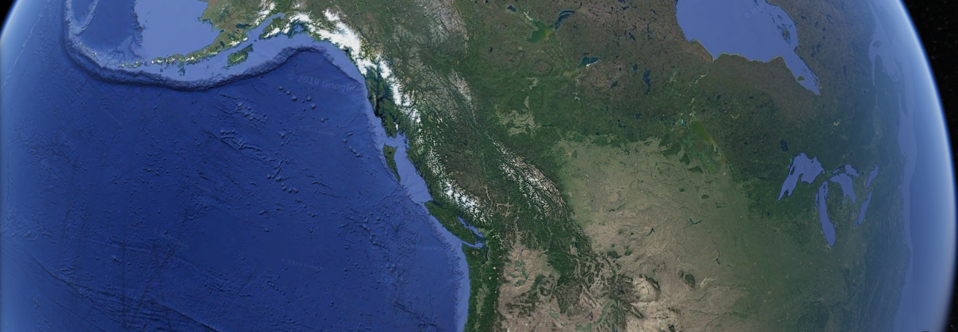
Goal
To perform an in depth assessment between maximum likelihood estimation, support vector machine, and neural networks machine learning algorithms for land cover classification models.

Slide 4
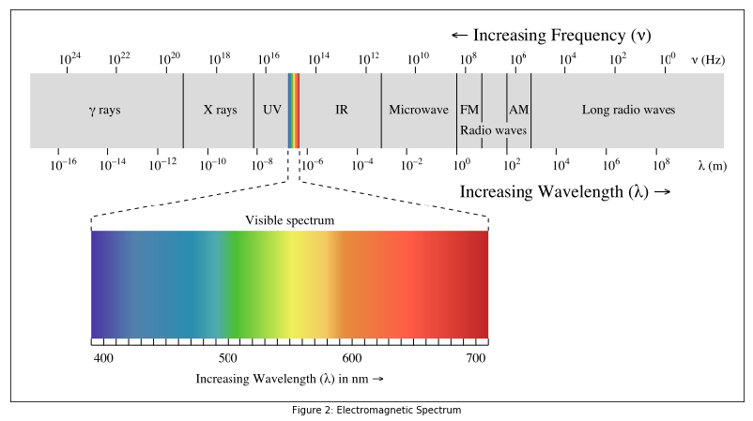
Background
Land development, natural resource management, or impact assessment studies
Tangible product
Satellites technology
Advancements in machine learning
PCI Geomatica, Jupyter Notebook, Python

Slide 5
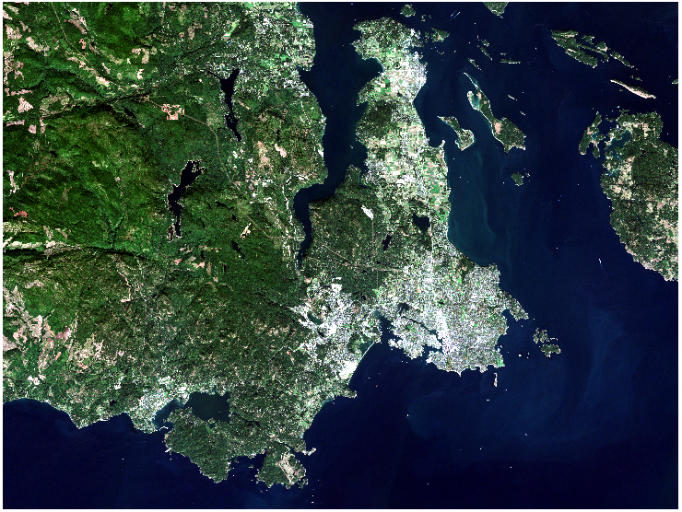
Study Area
Area 2,890 km²
28,896,685 pixels
11 bands
Land Cover Classes [1]
Urban/Barren
Forest
Shrub
Agriculture
Grassland
Wetland
Water

Slide 6

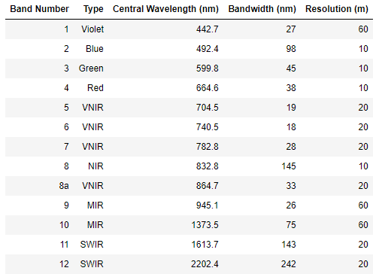
Data
Sentinel 2A
European Space Agency
Level 1C product
13 spectral bands
10, 20, and 60 metre spatial resolution [2]
Notes:
Explained more in Training Samples slide

Slide 7

Methods
Data Preprocessing
Training Sample Selection
Data Processing
Land Classification
PCI Maximum Likelihood Estimation
Maximum Likelihood Estimation
Support Vector Machine
Neural Network
Algorithm Accuracy Assessment
Statistical Comparison Between Algorithms

Slide 8
Methods
Classification Algorithms
Accuracy Assessment
Data Preparation
PCI Maximum Likelihood Estimation
Overall Accuracy
Stratified K-Fold Cross Validation
Atmospheric Correction
Each Model’s Output
Confusion Matrix
Producer’s & User’s Accuracy
Maximum Likelihood Estimation
Spatial and Spectral Subset
Precision, Recall, F-Measure
Kappa Coefficient
Parameter optimization
Training Samples
Support Vector Machine
Train/Test Split
Statistical Comparison
Each Model ‘s Output
Neural Network
McNemar Test

Slide 9
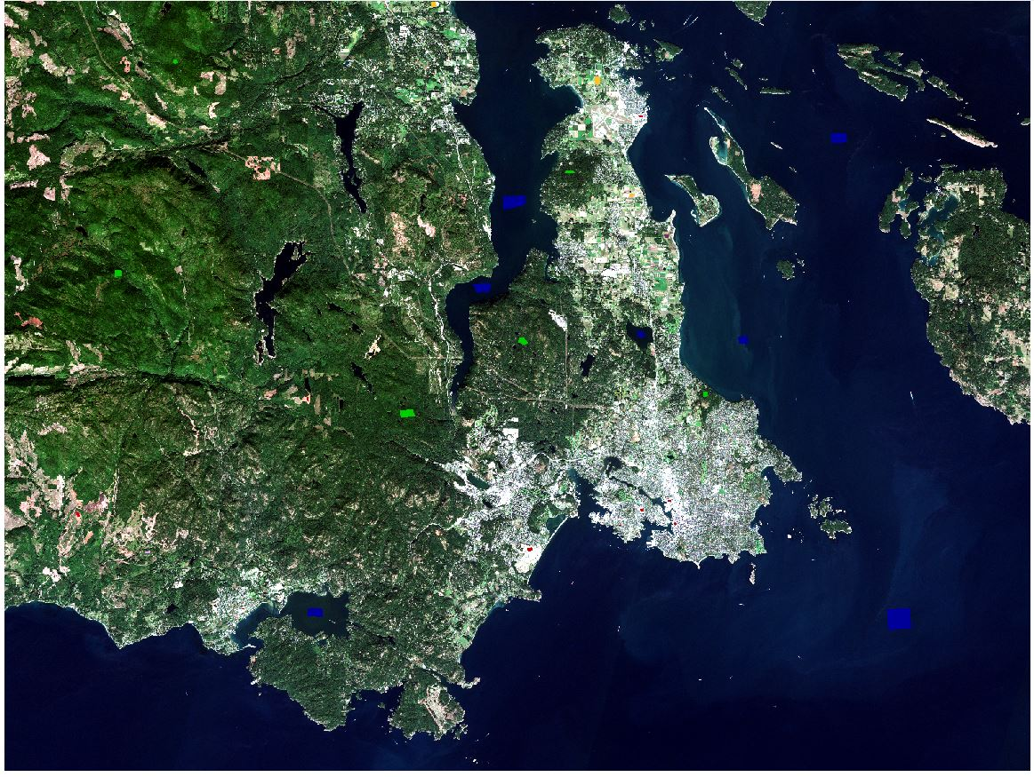
Data Processing
Preprocessing
Atmospheric Correction
Spatial and Spectral Subset
2. Training Sample Selection
Homogenous sites
Spectral Signature Separability
3. Processing
Train/Test Split of 70%/30%

Slide 10
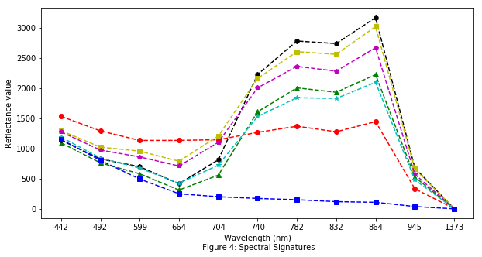
Training Samples
Bhattacharyya Distance→1.86
Transverse Divergence→1.95

Slide 11
PCI Maximum Likelihood Estimation
Black box
Notes:
http://www.pcigeomatics.com/geomatica-help/references/pciFunction_r/modeler/M_mlc.html

Slide 12
PCI Maximum Likelihood Estimation
Determine if the pixel is within the hyperellipsoid for the class
If not assign a NULL class, otherwise calculate the Mahalanobis minimum distance classifier
Calculate the “a posteriori” with Bayes Rule
Assumes Gaussian distribution for all feature classes [3]
Notes:
http://www.pcigeomatics.com/geomatica-help/references/pciFunction_r/modeler/M_mlc.html

Slide 13
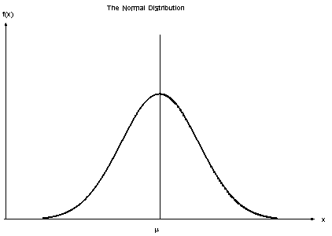

Maximum Likelihood Estimation
Very common in remote sensing
Class Mean and Covariance Matrix
Gaussian Probability Distribution
Assumed Independent and Identical [4,5]

Slide 14
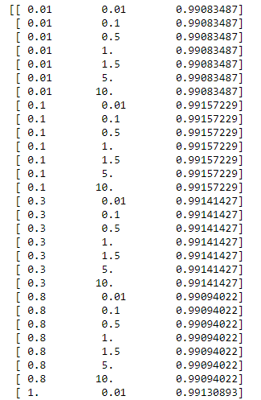
Support Vector Machines
Kernels:
Radial Basis Function → attempted
Linear
Polynomial → 3rd order
Cost = 1.0
Gamma = 1/Number of Features

Slide 15
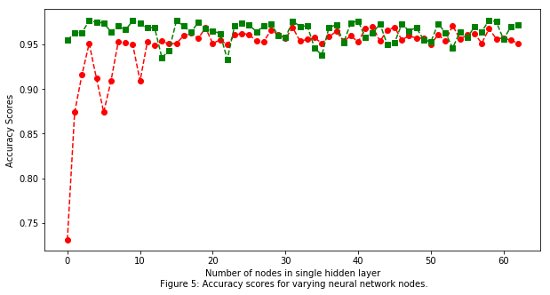
Neural Network: Multi-Layer Perceptron
Number of hidden Layers: 1
Activation Functions:
Tahn → 55 nodes
Identity → 30 nodes
Adam Solver [6]
Alpha = 0.0001
Learning Rate = 0.001
Notes:
Tahn = hyperbolic tahn function
Solver = weight optimization
A = regularization
Learning = weight update

Slide 16

Algorithm Accuracy Assessment
Overall Accuracy
Confusion Matrix
Stratified K-fold Cross Validation
Average Accuracy
Average F-measure
Precision, Recall, and F-measure [7]
Producer’s and User’s Accuracy
Probability reference pixel is correctly labelled
Probability a pixel’s classification represents ground truth [8]
Kappa Coefficient
Different from random [9]

Slide 17
Statistical Assessment Between Algorithm
McNemar Test
Statistically Significant Difference of Errors
Binary metrics → Contingency Table
Chi-square Statistic
p-value [10]
Contingency Table
 | MLA 2 | MLA 2
MLA 1 | True/True | True/False
MLA 1 | False/True | False/False

Slide 18
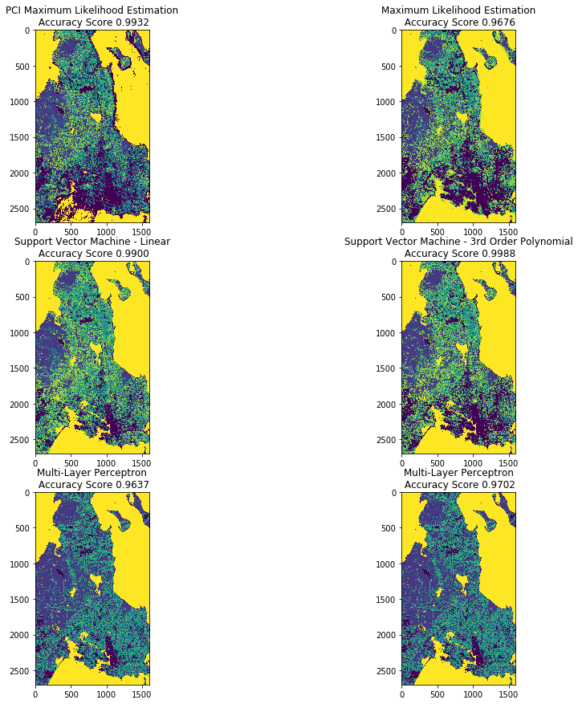
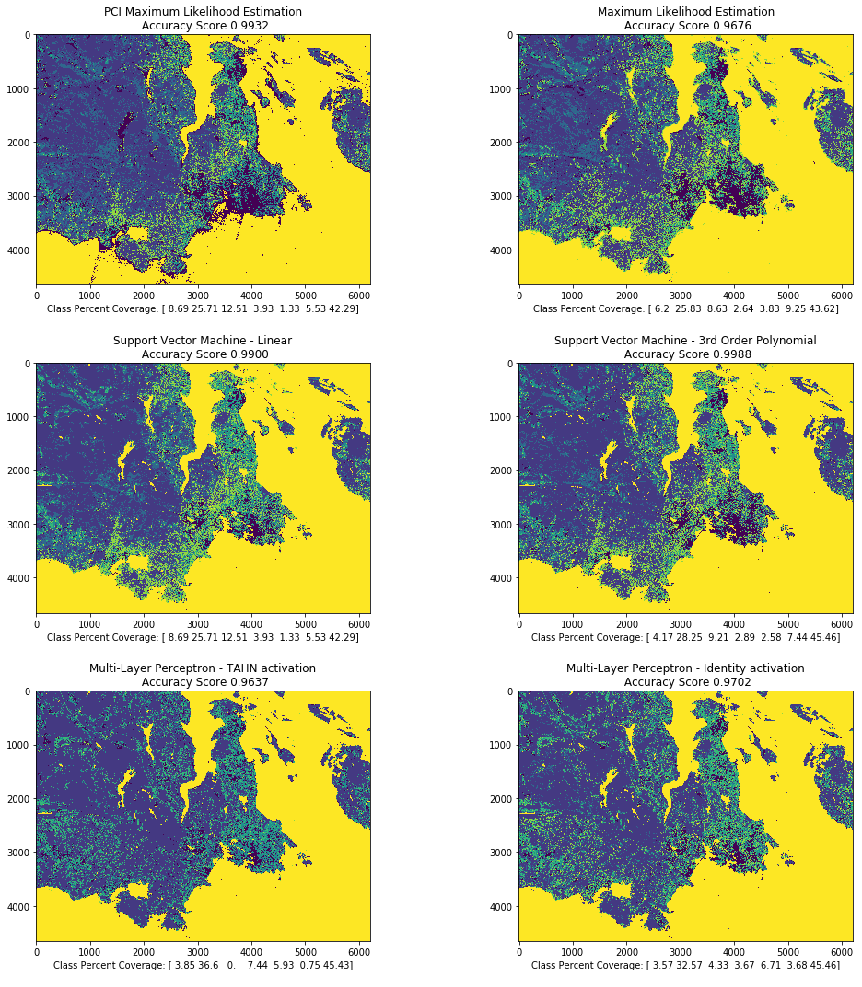
Results

Slide 19
Overall Accuracy
Visual inspection
> 96% overall accuracy score
Ranking:
SVM polynomial kernel
PCI MLE
SVM linear kernel
NN identity activation function
MLE
NN tahn activation function

Slide 20
Overall
Overall Accuracy
PCI MLE
Errors → water
NN
Errors → forest
Lacking Complexity

Slide 21
Overall Accuracy
MLE
Errors → water
SVM
Complex
NN
Errors → forest
Lacking Complexity

Slide 22
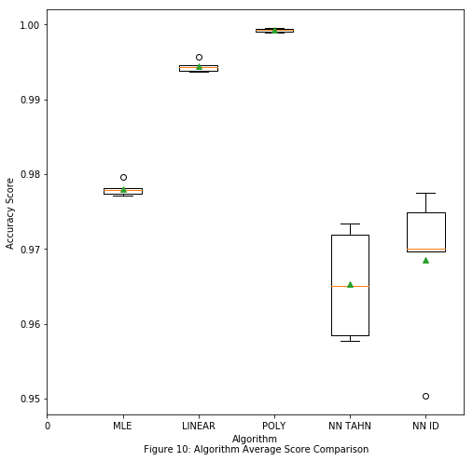
Stratified K-fold Cross Validation
MLA | Overall Accuracy | Mean Accuracy
PCI MLE | 99.32% | 97.38%
MLE | 96.67% | 97.8%
SVM Linear | 99.13% | 99.44%
SVM Polynomial | 99.84% | 99.90%
NN Tahn | 96.44% | 96.06%
NN Identity | 97.16% | 97.38%

Slide 23
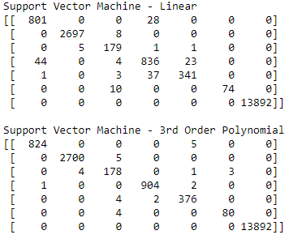
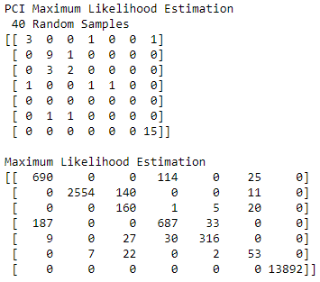
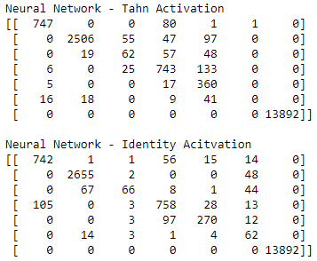
Confusion Matrices

Slide 24
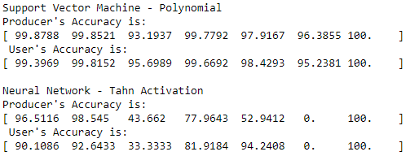
Kappa Coefficient - Producer’s & User’s Accuracy
Kappa Coefficient
PCI MLE → 98.47
MLE → 92.43
SVM Linear → 98.02
SVM Polynomial → 99.63
NN Tahn → 91.93
NN Identity → 93.53
Producer’s & User’s Accuracy
Water → 100%
Shrub & Wetland → lowest
SVM Polynomial best overall
NN Tahn worst overall

Slide 25
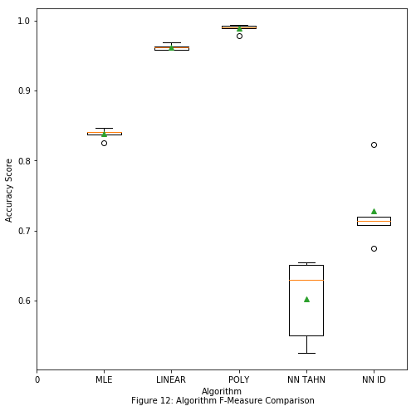
Precision, Recall, & F-Measure
MLA | Overall Accuracy | Mean Accuracy | F-Measure
PCI MLE | 99.32% | 97.38% | N/A
MLE | 96.67% | 97.8% | 83.79%
SVM Linear | 99.13% | 99.44% | 96.18%
SVM Polynomial | 99.84% | 99.90% | 98.86%
NN Tahn | 96.44% | 96.06% | 57.58%
NN Identity | 97.16% | 97.38% | 76.96%

Slide 26
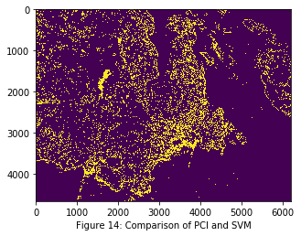
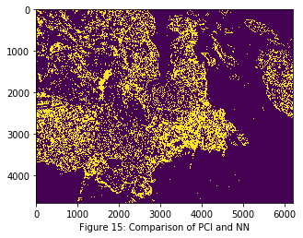
McNemar Test
Statistically Significantly Different
All p-values < 0.001
Pixels classified differently for each MLA
Largest Percent Difference → 26.6%
Smallest Percent Difference → 17.9%

Slide 27
Conclusion
1st: SVM 3rd Order Polynomial was the best across all statistics → Slow Speed
2nd: MLE performed well overall → Medium Speed
3rd: NN was the worst across all statistics → Fast Speed

Slide 28
Conclusion
Limitations:
Uneven sample sizes for each feature class
Difficulty finding optimal parameters for SVM and hyperparameters for Neural Network
Computing power/time limited for RBF kernel
Future Studies:
More even distribution of pixels between feature classes
Parameters/hyperparameters taylored to this study area
Exploration of different spectral bands and higher levels products (eg. NDVI) []

Slide 29
Acknowledgements
Thank you to Dr. Neil Ernst for supervising this project, and to David Johnson for his advice during this process.
Special thanks to Dr. Randy Scharien and Terry Evans for giving me a broad understanding of remote sensing throughout my degree; and to Dr. George Tzanetakis and Dr. Alex Thomo for providing a solid base to build my machine learning abilities on.

Slide 30
References
[1] Frisk, J. 2011. Guidance for the preparation of ESTR products – land classification scheme. Canadian Biodiversity: Ecosystem Status and Trends 2010, Technical Thematic Report No. 3. Canadian Councils of Resource Ministers. Ottawa, ON. iv + 34 p. http://www.biodivcanada.ca/default.asp?lang=En&n=137E1147-1
[2] ESA (2019) Sentinel Online User Guides: https://earth.esa.int/web/sentinel/user-guides/sentinel-2-msi/resolutions/radiometric
[3] PCI Geomatic’s (2018) Maximum Likelihood Classifier: http://www.pcigeomatics.com/geomatica-help/references/pciFunction_r/modeler/M_mlc.html
[4] Pedregosa et al., (2011) Scikit-learn: Machine Learning in Python. JMLR 12, pp. 2825-2830.
[5] Tzanetakis, G. (2017) Course Slides from SENG 474 Introduction to Machine Learning. University of Victoria.
[6] Kingma, D. & Ba, J. (2015) Adam: A Method for Stochastic Optimization. ICLR conference paper
[7] Di Martino, M., Hernadez, G., Fiori, M., & Fernandex, A.(2013) New framework for optimal classifier design. Pattern Recognition, 46, 2249-2255; doi:https://doi.org/10.1016/j.patcog.2013.01.006
[8] Comber, A.J. (2013) Geographically weighted methods for estimating local surfaces of overall, user and producer accuracies. Remote Sensing Letters, 4:4, 373-380; doi:10.1080/2150704X.2012.736694
[9] Ganbold, G. & Chasia, S. (2017) Comparison between Possibilistic c_means (PCM) and Artificial Neural Network (ANN) Classification Algorithms in Land use/Land cover Classification. International Journal of Knowledge Content Development & Technology, Vol. 7, No.1, 57-78; doi:https://doi.org/10.5865/IJKCT.2017.7.1.057
[10] Li, X., Chen, W., Cheng, X., & Wang, L. (2016) A Comparison of Machine Learning Algorithms for Mapping of Complex Surface-Minded and Agricultural Landscapes Using ZiYuan-3 Stero Satellite Imagery. Remote Sensing, 8, 514; doi:10.3390/rs8060514

